Slide 1
Convolutional Image Processing EC 526 - Project Presentation
Yousif Khaireddin
William Martin
Zhuofa Chen
Ihor Leshchyshyn
Notes:
Good afternoon everyone, This is Zhuofa Chen, Our group focus on convolutional image processing using different parallelization techniques. Our group include, Yousif, WIllian, and Ihor.

Slide 2
Background and Overview
Notes:
I will start start with some background information and a quick overview of image processing.

Slide 3
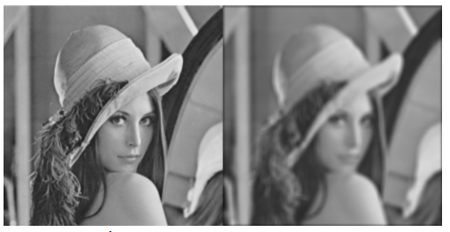
Image Filtering and Image Processing
Image filtering or image processing is used in many applications today
Many common filters include:
Denoising
Sharpening
FFT
Blurring / Deblurring
Edge detection
Object Detection
Laplacian
Figure 1: Blurring [1]
Notes:
As the development of computer vision, image processing is used everywhere. Among all the image processing techniques, filtering is a very important.
The commonly used filter in image processing includes, denosing, sharpening, blurring, edge detection etc. Here is an example of blurring filter. The left is the original picture, the right shows the effect of blurring.

Slide 4
Image Filtering and Image Processing (Continued)
These functions are done by sliding a filter across the initial image. [1]
This can be thought of as a convolution. [1]
Convolutions are extremely powerful and prevalent in machine learning. Convolutional Neural Networks
Due to this, there is a high demand for parallelized convolutions.
Figure 2: Image Convolution
Notes:
Convolution processing has been developed since last century. THe convolutional process express how the shape of one function is modified by the other function. For example, image convolution processing, the value of one pixel in the new image is calculates by summing the products of each pixel between original image and the filter. The new image is generated by move the filter across the original image. Since Alexnet got noticed in 2012, convolutional neural networks become a much more favoroble way in image processing. Thats why we focus on doing this parallelized convolutions.

Slide 5
Our work
Implemented serial 2D convolution for image processing
Applied different filters to an image using our convolution function
Re-implemented our code using OpenACC, OpenMP, and threading
Compared the performance of the different implementations
Notes:
Yousif

Slide 6
Experimental Results
Notes:
Yousif

Slide 7

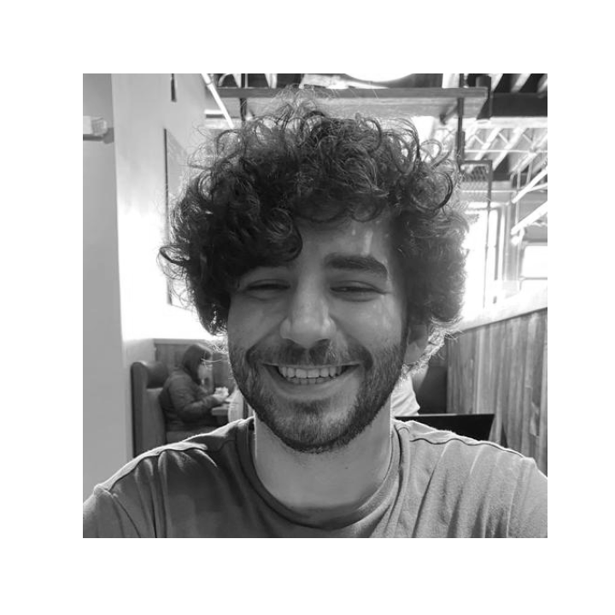
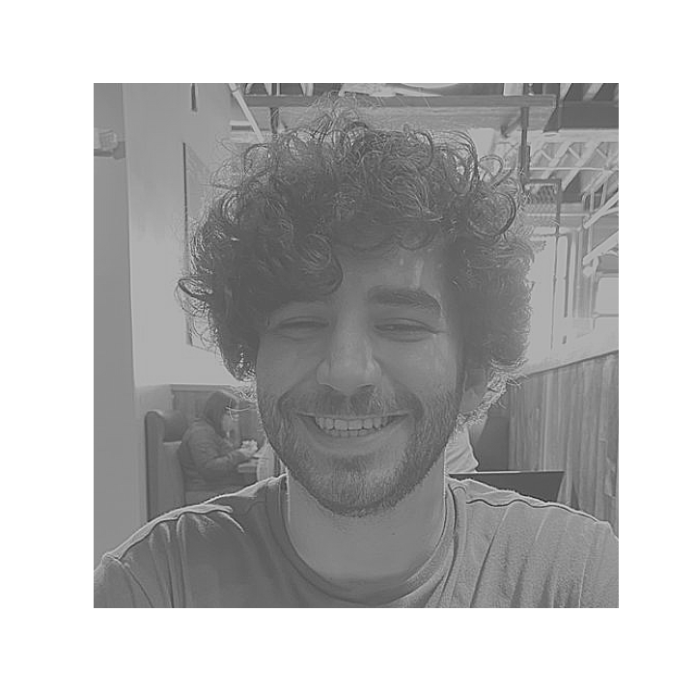
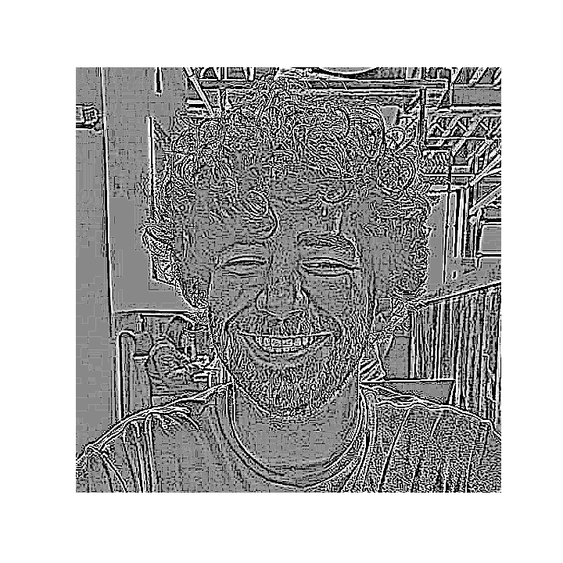
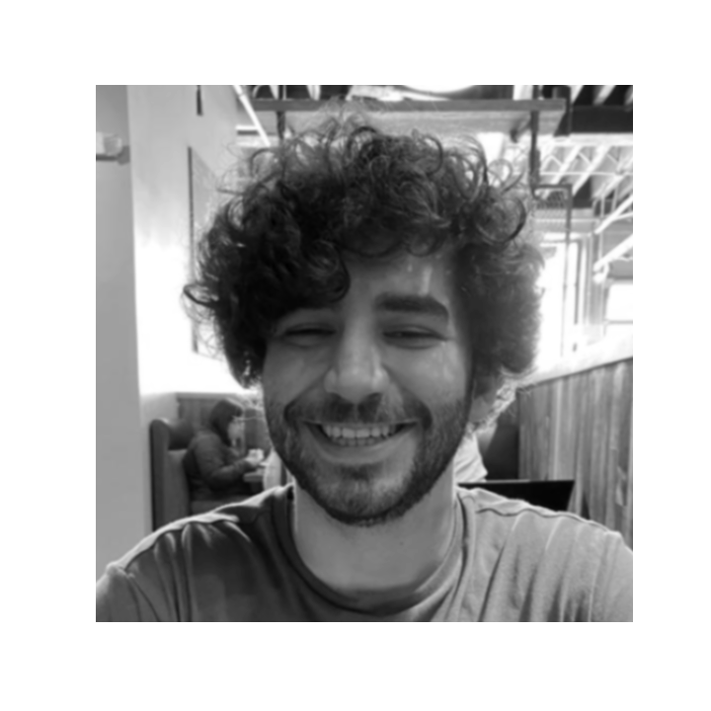
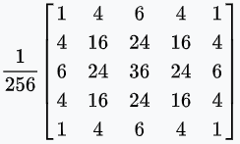
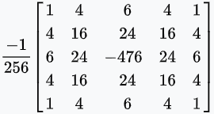


Image Processing Examples
Box Blurring
Gaussian Blurring
Unsharp masking
Edge Detection
Original
Notes:
Yousif

Slide 8
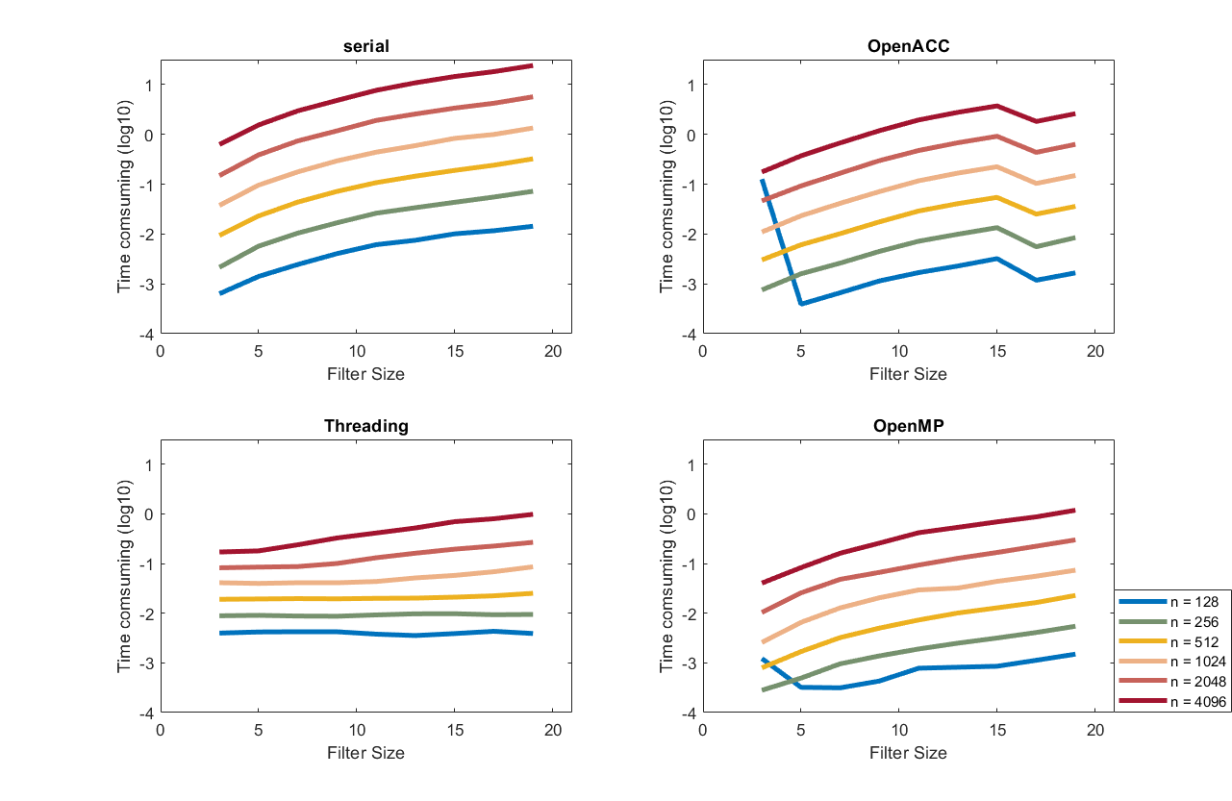
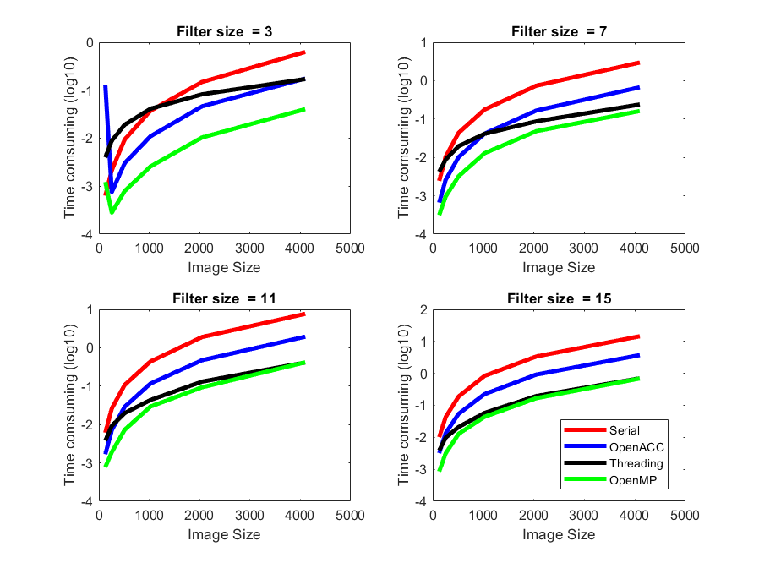
Performance Comparisons
Notes:
Will

Slide 9
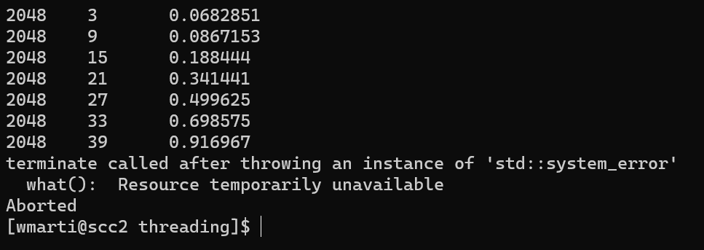
Challenges we faced?
C++ Threading via the SCC
Hardware limitation?
Notes:
Will

Slide 10
References
[1] https://ai.stanford.edu/~syyeung/cvweb/tutorial1.html
[2] https://en.wikipedia.org/wiki/Kernel_(image_processing)
Notes:
Will

Slide 11
Questions
Notes:
Everyone

